Slide 1
Vega: Container Based Cross-cloud Horizon VDI

Slide 2
Agenda
Background
Problems
Solution
Related work
Evaluation

Slide 3
Background
There are a lot of public cloud, however, none can serve each request from user
Government regulation
Unique functionality
Qingcloud’s VPC is better than Aliyun
AWS S3 is widely used
Security
Private cloud vs. public cloud
Global player vs. region player
Trend is many enterprises will leverage multiple public cloud to deploy VDI

Slide 4
Problems
Workload / data isolation
Different user accounts in different cloud
Dependency on cloud vendor
What if one cloud vendor exits market
Security vulnerability
More ports exposed to attack
Inconsistent security policy
Complexity in management and higher cost

Slide 5
Solution
Solution
Vega enables enterprise to run, manage, migrate and secure virtual desktops cross cloud using unified software interface and allow end user from anywhere to access desktop on cloud with the lowest latency.
Benefits
No data isolation
Desktop on any cloud installed with VDI agent can be managed by Vega
Able to choose desktop from clouds most suitable according to user’s preference
No dependency on a single cloud vendor since workload can migrate seamlessly
Admin can assign cloud weight flexibly (To reduce cost or meet compliance)

Slide 6
Architecture Overview
Components of Desktop manager are designed to cross cloud
The floating desktop pool maintains desktop instance cross cloud, from which a desktop is allocated each time user login
Notes:
Front end service interacts with clients. It uses docker swarm to scale and load balance between clouds.
Distributed data store provide user and desktop data to front end service. It focus on scale between cloud with low network latency.
Implement in Node.js which can handle large number of IO async without much memory overhead
Packaged in docker image and runs in container
Orchestrated by docker swarm
It communicates with distributed data store over network using RESTFul API. However, data cache is designed to reduce network latency on critical path
Desktop entitlement service
User list desktop item
More read, little write. Optimize read latency
Desktop allocation service
User connects desktop
Many read and write
Design local cache near to front-end service to reduce latency

Slide 7
Main Challenges
As components distribute cross cloud, how to keep data consistency while amortizing network overhead?
How to tolerate fault considering the node fault rate may be higher?
There are a lot of defects with docker swarm in cross cloud and load balance.

Slide 8
Related work
Horizon on Azure/AWS
VDI on different clouds can’t connect with each other
VMware cross cloud architecture
It mainly addresses this issue in SDDC level, while Vega addresses it in DASS level

Slide 9
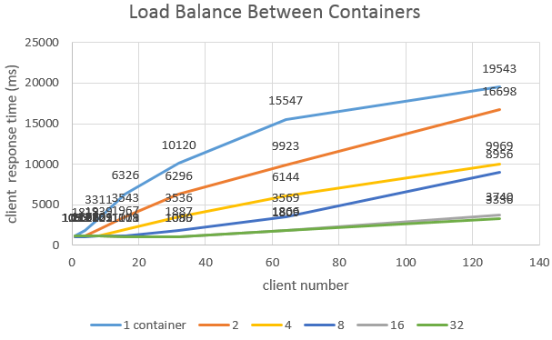
Evaluation
DM Migration Cross Cloud
Front end service migration based on docker swarm
DM Scales Cross Cloud

Slide 10
Questions?
10

